Slide 1


THM model recap
Shihao Cui
July 23, 2025
Department of Civil, Geological and Mining Engineering

Slide 2
Thermal Model

Slide 3
Problem
Energy
Soil
Soil
Temperature signal
Sensor 1
Thermal properties

Slide 4
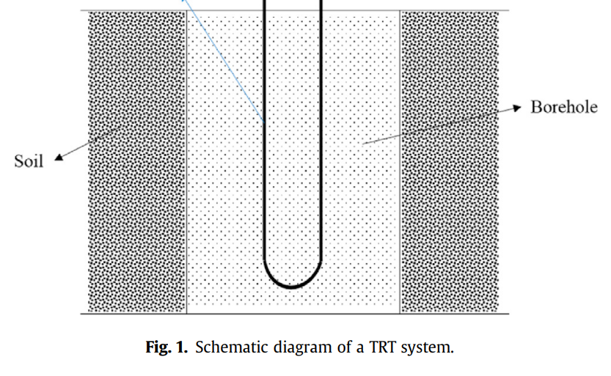
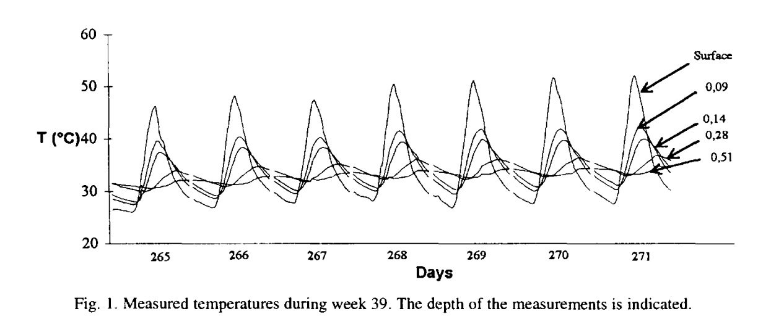
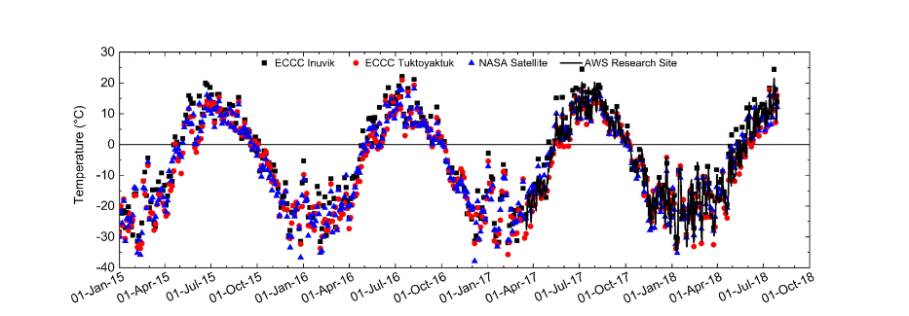
Experimental Data
Depth
z
(Alain et al., 1996)
(Zhang et al., 2021)
Experimental setup
Thermal sensor
Earl et al., 2021

Slide 5
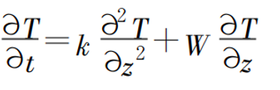
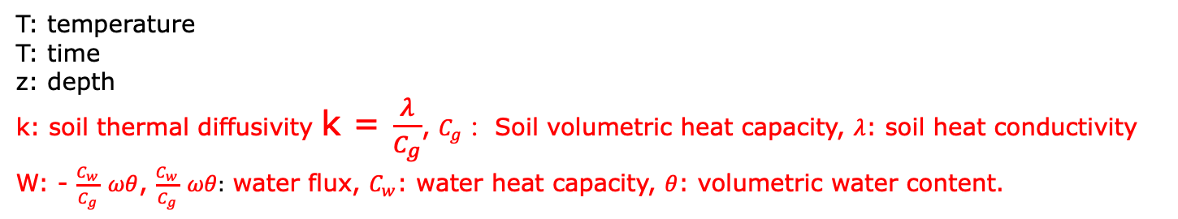
Methodology
Forward model- Analytical solution of the heat transfer equation
Governing Equation
Analytical solution
T: temperature
T: time
z: depth
k: soil thermal diffusivity k = $\frac{λ}{C_{g}}$, $C_{g}$： Soil volumetric heat capacity, $λ$: soil heat conductivity
W: - $\frac{C_{w}}{C_{g}}$ $ωθ$, $\frac{C_{w}}{C_{g}}$ $ωθ:$ water flux, $C_{w}$: water heat capacity, $θ$: volumetric water content.
Conduction;convection;Radiation

Slide 6





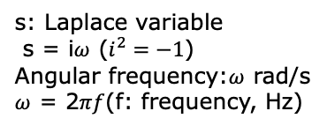



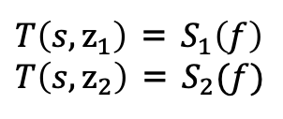

Methodology
Analytical solution by spectral element method
s: Laplace variable
s = i$ω$ ($i^{2}=−1$)
Angular frequency:$ω$ rad/s
$ω$ = 2$πf$(f: frequency, Hz)
Laplace transform:
$sT\left(s,z\right)=k\frac{∂^{2}T(s,z)}{∂z^{2}}$+W $\frac{∂T(s,z)}{∂z}$
Helmholtz equation
$T\left(s,z\right)$ = C*exp{-$\frac{z}{2k}$(W+$\sqrt{W^{2}+4Kωi}$)}+C2*exp{$\frac{z}{2k}$(-W+$\sqrt{W^{2}+4Kωi}$)}
z$→+∞, T\left(s,z\right)$ $→0.$
C2=0
C and C2 are undetermined arbitrary constants.
General solution
$T\left(s,z\right)$ = C*exp{-$\frac{z}{2k}$(W+$\sqrt{W^{2}+4Kωi}$)}
o
$∆$ = $z_{2}$ - $z_{1}$
$$z_{1}$$
$$S_{1}\left(t\right)$$
Fourier transform
$T\left(s,z_{1}\right)$ = $S_{1}\left(f\right)$
$T\left(s,z_{2}\right)$ = $S_{2}(f)$
$$∆$$
$$z_{2}$$
$$S_{2}\left(t\right)$$
z

Slide 7

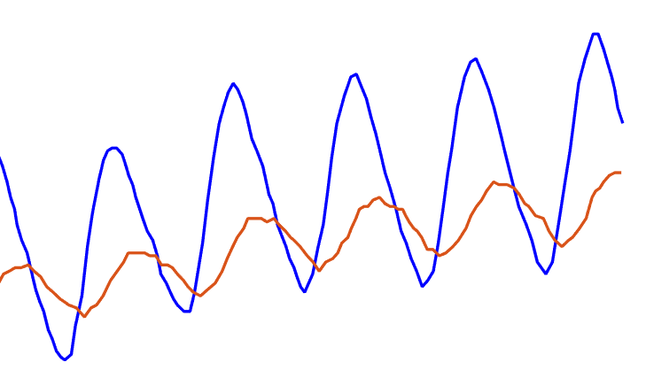





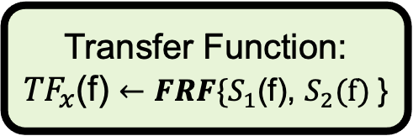
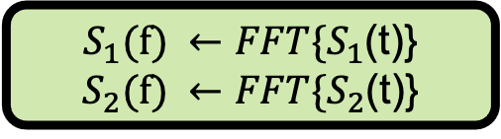




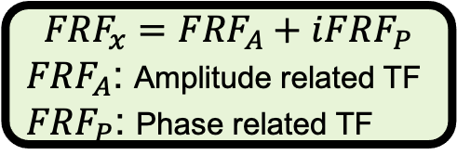
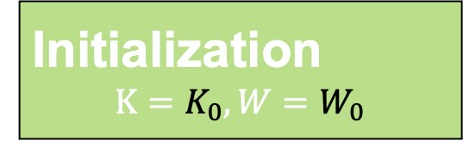

Traditional inversion
(a)
(b)
o
x
$S_{1}(f) ←{FFT\{S}_{1}$(t)}
$S_{2}(f) ←{FFT\{S}_{2}$(t)}
$$S_{1}$$
$$S_{1}(t)$$
$$S_{2}(t)$$
Transfer Function:
${TF}_{x}$(f) $←{FRF\{S}_{1}$(f), $S_{2}(f)$}
$∆$z
Temperature
$$S_{2}$$
z
Soil
Time
$${FRF}_{x}={FRF}_{A}+i{FRF}_{P}$$
${FRF}_{A}$: Amplitude related TF
${FRF}_{P}$: Phase related TF
Investigated field
(c)
Initialization
$$K=K_{0},W=W_{0}$$
Loss function:
Amplitude: F = F1 OR
Phase: F = F2 OR
Hybrid: F = F1+F2 , where
F1 = ${||{FRF}_{A}−ℛ\text{(}{FRF}_{a}\text{)}||}^{2}$
F2 = ${||{FRF}_{P}−\text{ℑ}\text{(}{FRF}_{a}\text{)}||}^{2}$
Estimation result:
$$K^{∗},W^{∗}$$
Yes
Convergent?
NO
(d)
Updating $(K,W)$ by PSO
Forward model: ${FRF}_{a}$(K,W)

Slide 8
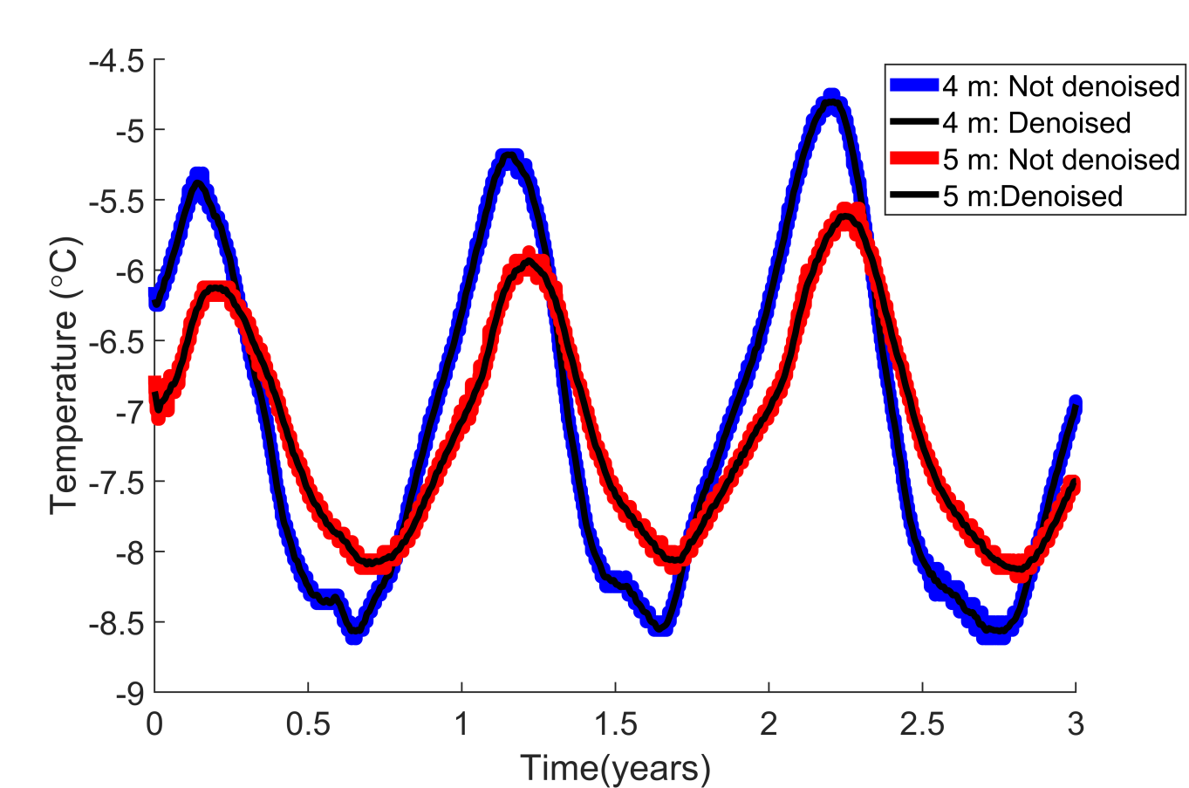
Experimental analysis
Sampling frequency inconsistency (12/day)
Data missing-- Interpolation
Noises: denoising by discrete wavelet transform(DWT)
Soil
DWT: 5 layers; soft threshold;
‘sqrwolog’, wavelet: ‘db8’

Slide 9
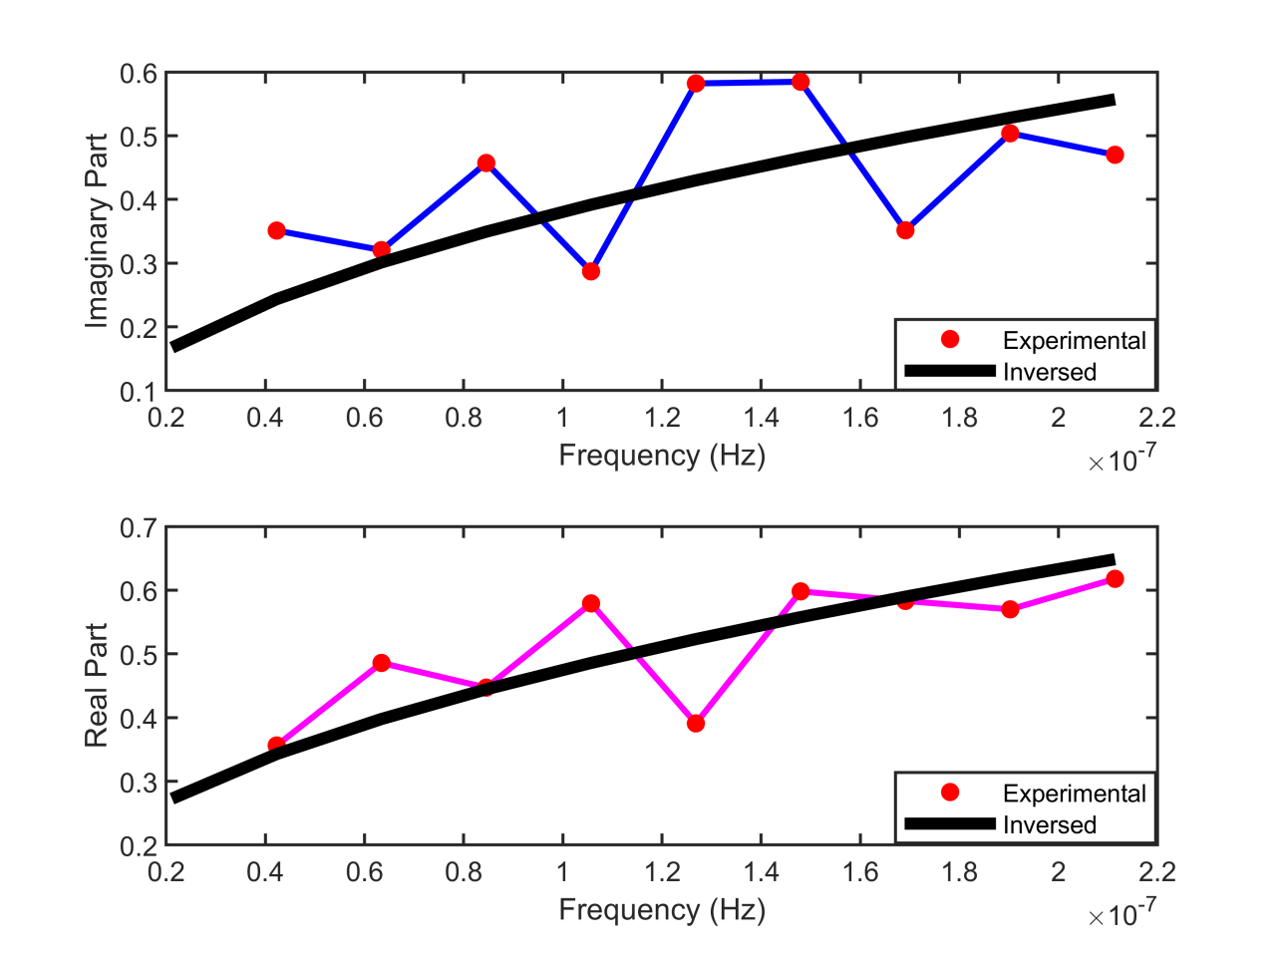
Experimental analysis
Inversion using both (Amplitude and Phase information: F1 and F2)
Soil

Slide 10
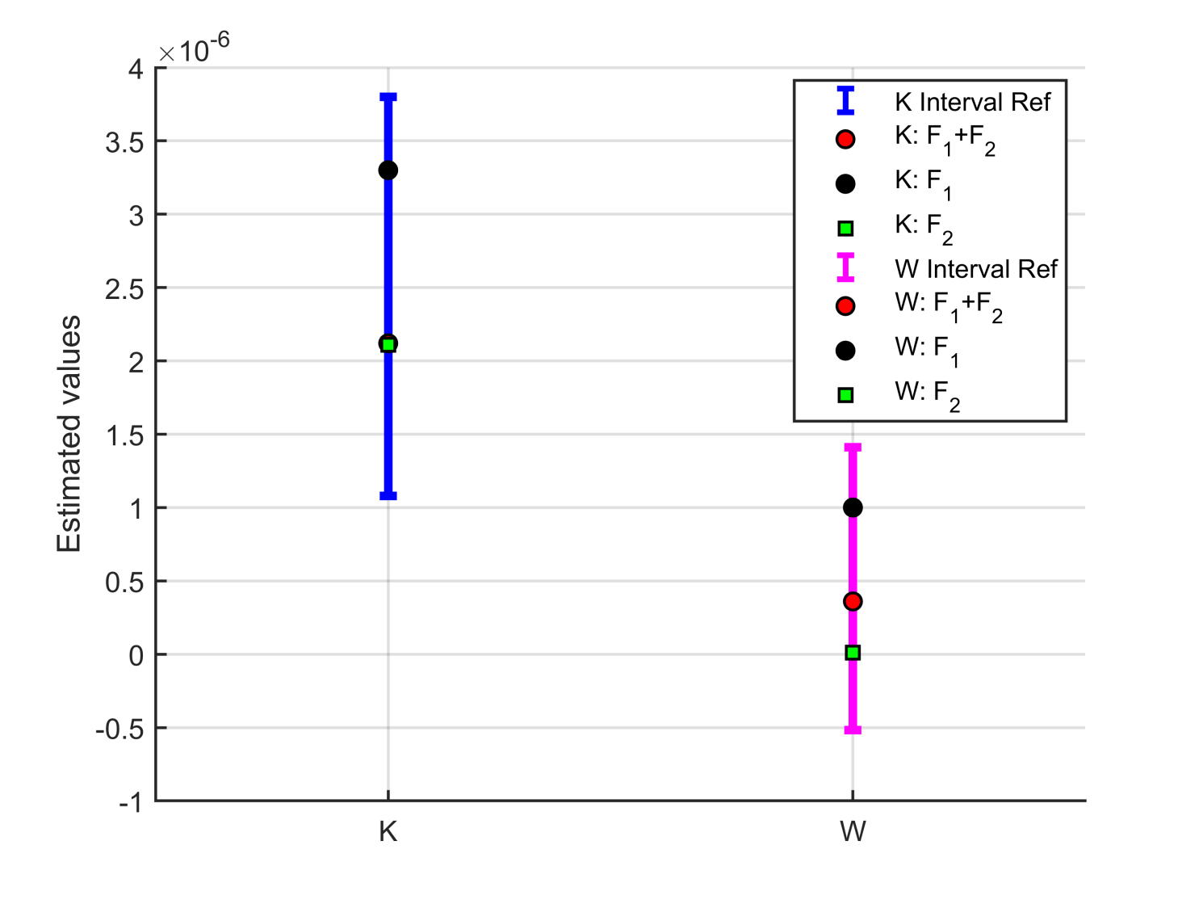
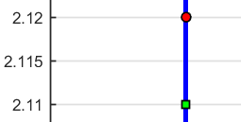
Experimental analysis
Result of inversion
Tong, Bing, Zhiqiu Gao, Robert Horton, and Linlin Wang. "Soil Apparent Thermal Diffusivity Estimated by Conduction and by Conduction–Convection Heat Transfer Models." Journal of Hydrometeorology 18, no. 1 (2017): 109-118.
Have to use two parts.

Slide 11
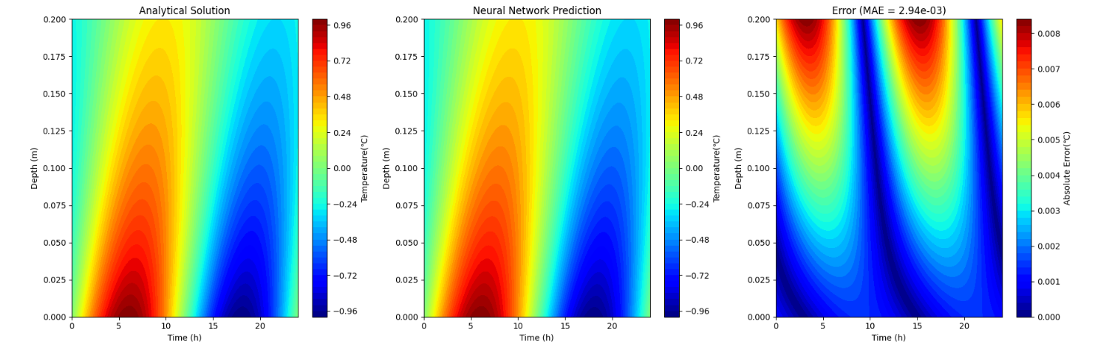
Physics informed Neural Networks (PINNs)
Forward model

Slide 12
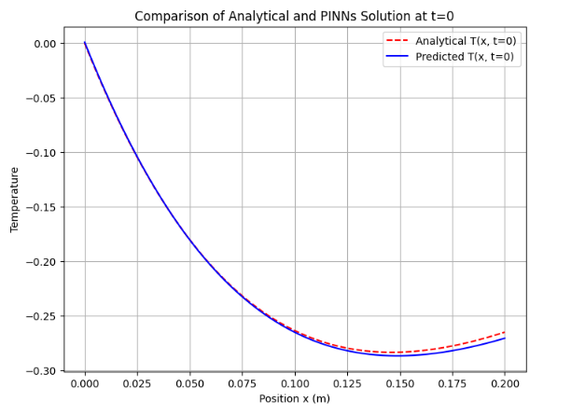
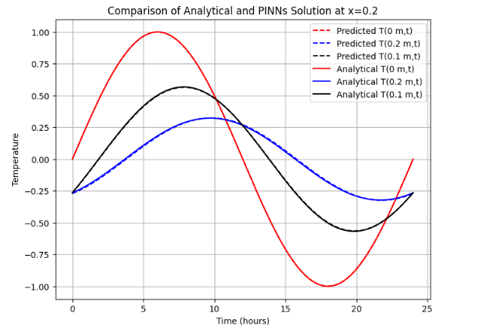
Physics informed Neural Networks (PINNs)
Forward model

Slide 13
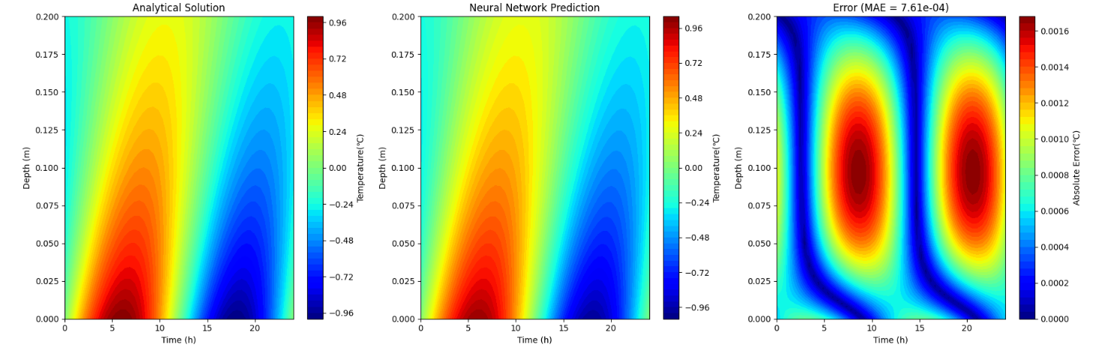

Physics informed Neural Networks (PINNs)
Inversion model

Slide 14
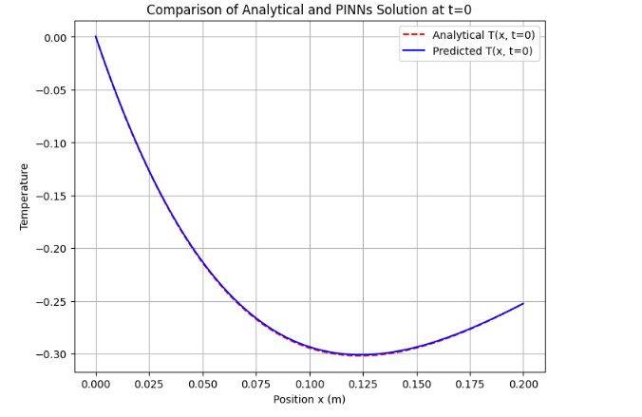
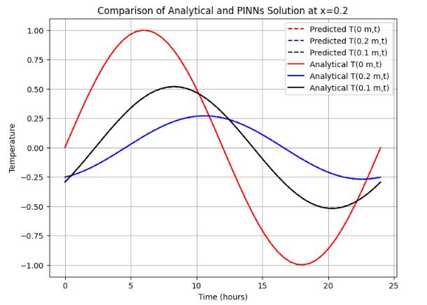
PINNs

Slide 15
Model TH considering phase change

Slide 16
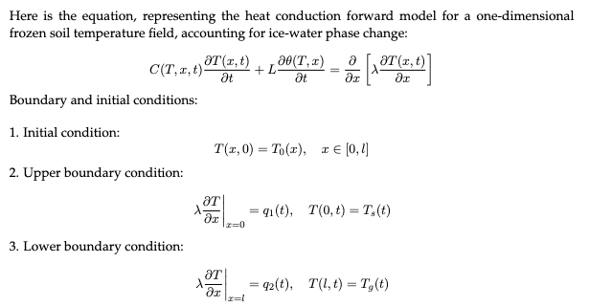
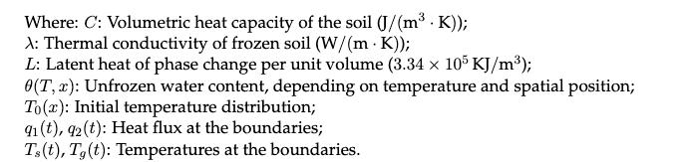

Slide 17
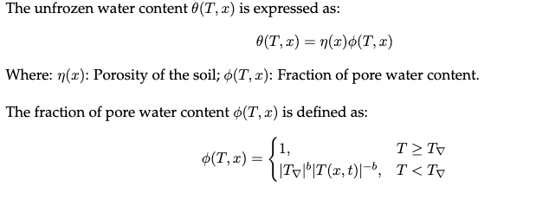

Slide 18
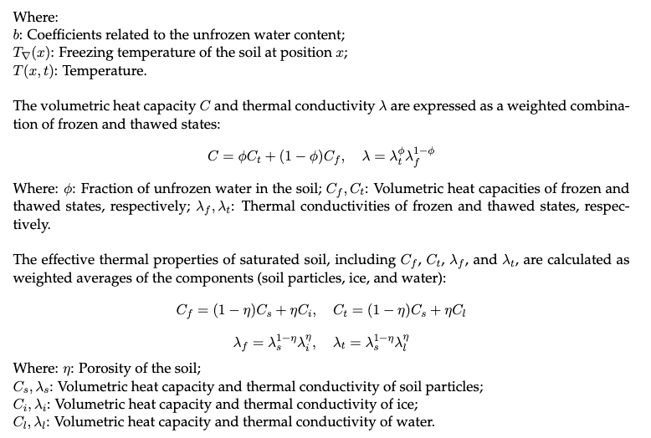

Slide 19
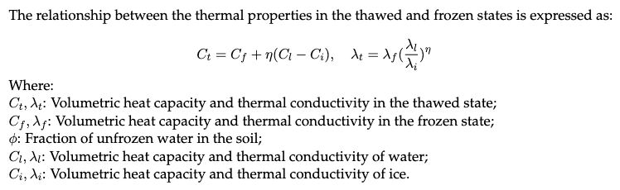

Slide 20
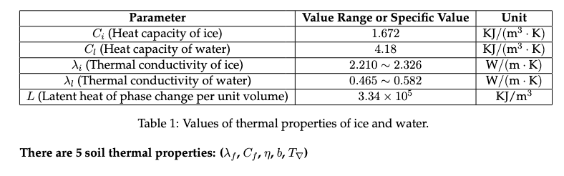

Slide 21
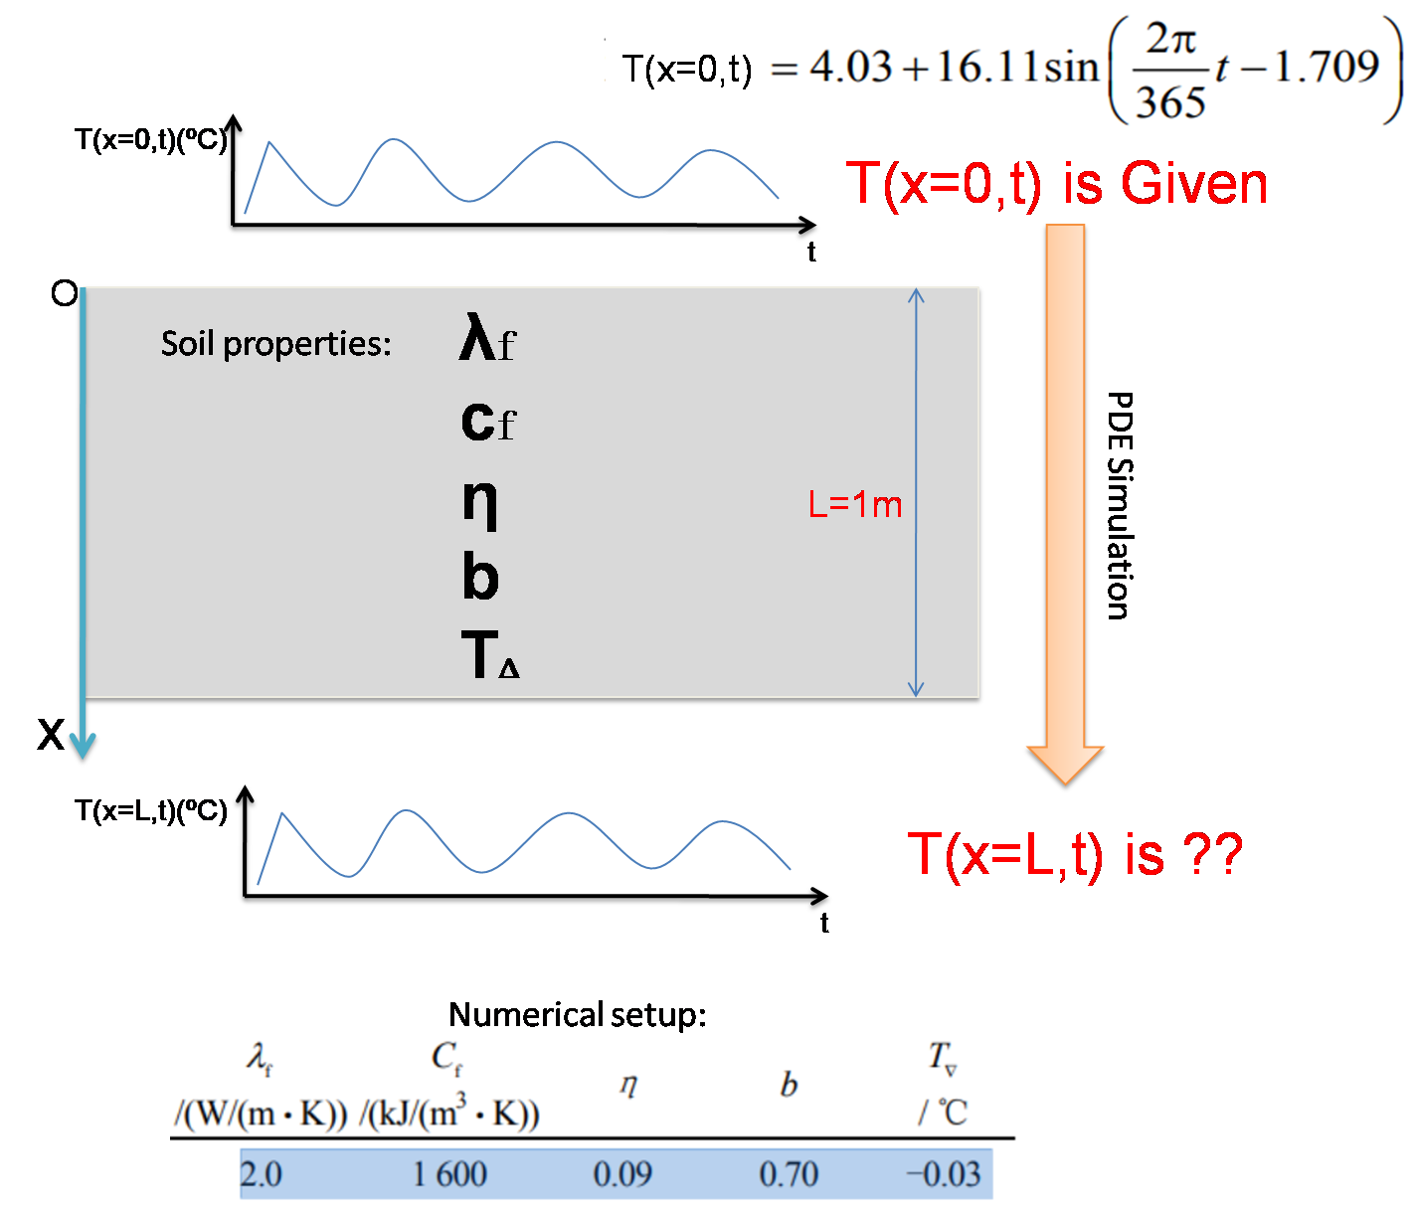

Slide 22
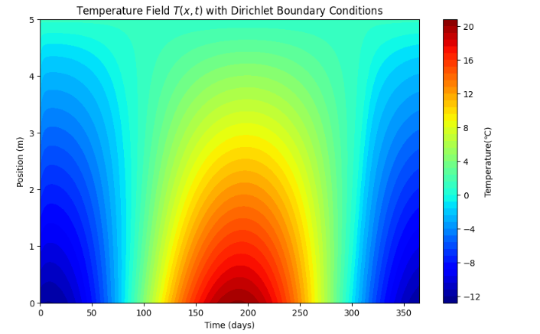
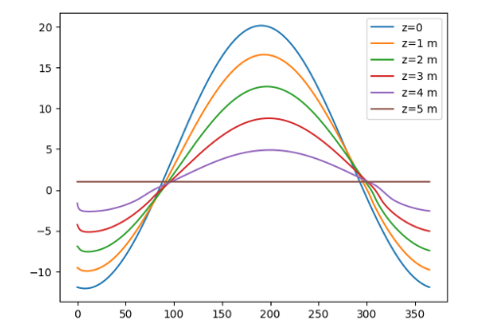
Forward model
Finite element methods (FDM)

Slide 23
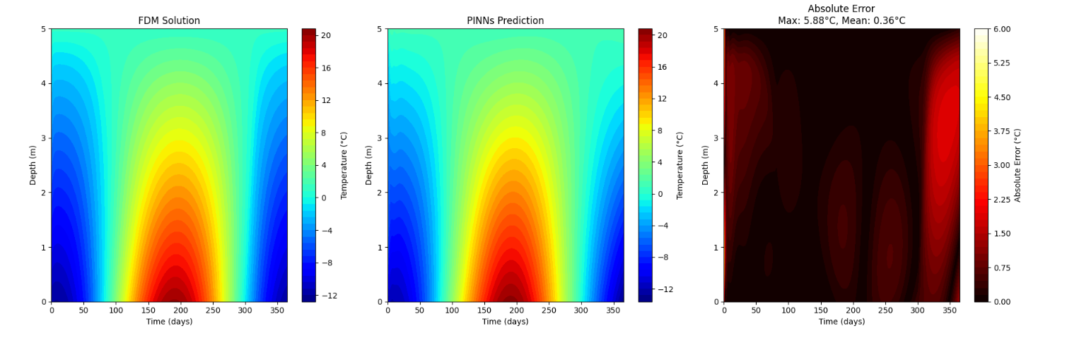
Physics informed Neural Networks (PINNs)

Slide 24
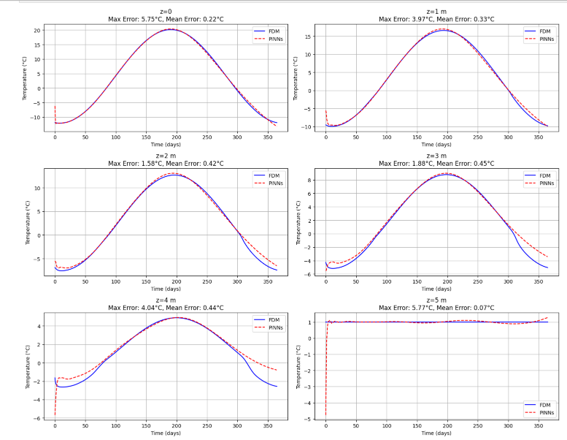
Physics informed Neural Networks (PINNs)

